Slide 1
Human Resource Analysis Project
Technical Provider: ACICT- AST
Instructor: Ahmed Abd Ellatife

Slide 2
Team Members and Their Tasks
Team Members:
Mohamed Alaa Eldin Mohamed Ibrahim
Task: Answer analysis questions using SQL, explore data to help add some data points in python, perform statistical analysis on the dataset and assist with data analysis by writing Conclusion & Recommendations.
Kerollos Girgis Dawoud
Task: Clean the dataset using Python and assist with data analysis.
Raneem Essam Abdelwahed
Task: Answer analysis questions in Python, create visuals using Python, and assist in data analysis.
Mohanad Mohamed Yasser
Task: Create the project blueprint and assist in data analysis.
Nariman Mohamed Saad
Task: Build the Tableau dashboard and assist in data analysis.
Note:
Each team member contributed to writing their respective parts of the final report.

Slide 3
Project Overview
Project Title : Human Resource Analysis
Objective :
- Analyze HR data to uncover insights related to employee turnover, performance ratings, and other key HR metrics. The analysis will help decision-makers understand workforce trends and try to predict future outcomes .
Tools Used :
Python (Pandas, Matplotlib)
SQL
Tableau for dashboard visualization

Slide 4
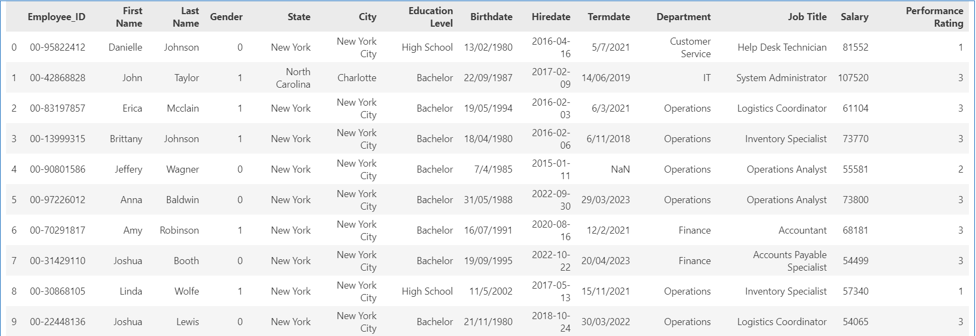
Data Overview
Number of Employees(Rows): 8,767
Key Columns:
Employee ID
First Name
Last Name
Gender
State
City
Education Level
Birthdate
Hire Date
Term Date
Department
Job Title
Salary
Performance Rating

Slide 5
Data Cleaning

Slide 6
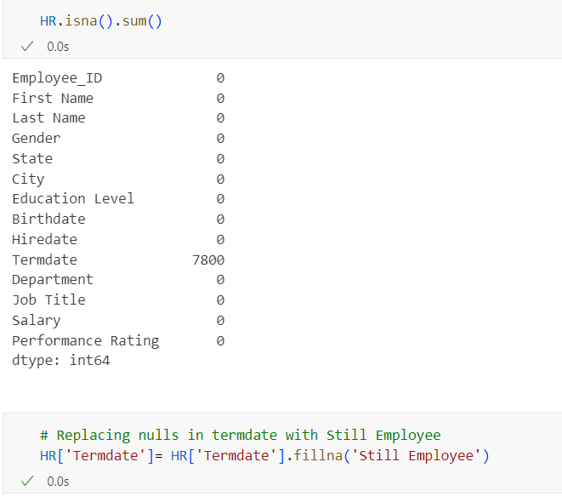
a- Handling missing values.
There are 7,800 missing values in the “Termdate" column, and they have been replaced.

Slide 7
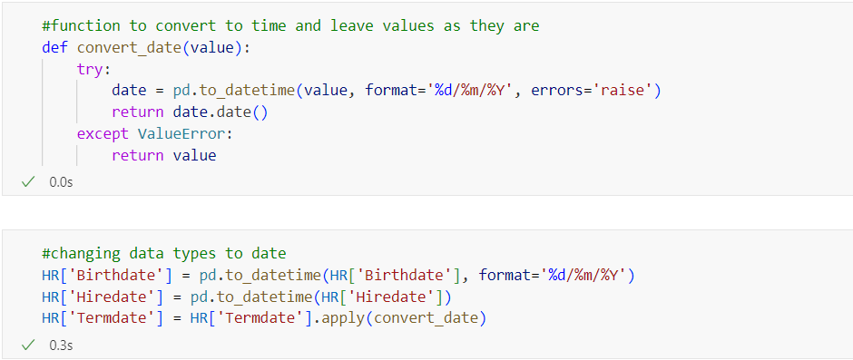
b-The column formats were converted to the appropriate format.

Slide 8
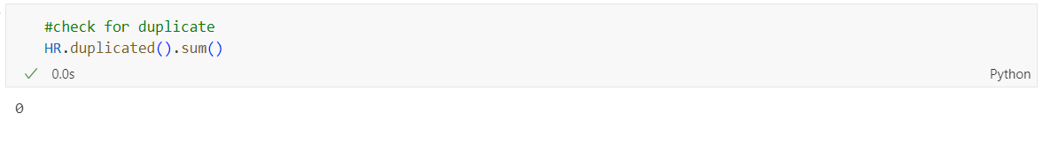
c- Handling duplicates.
There Are No duplicates in data .

Slide 9
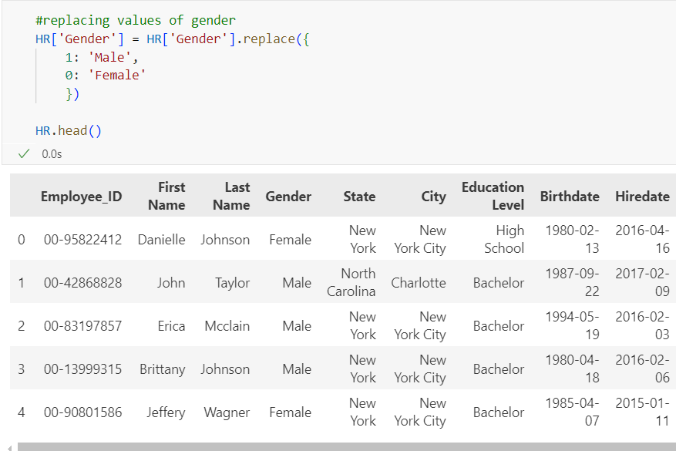
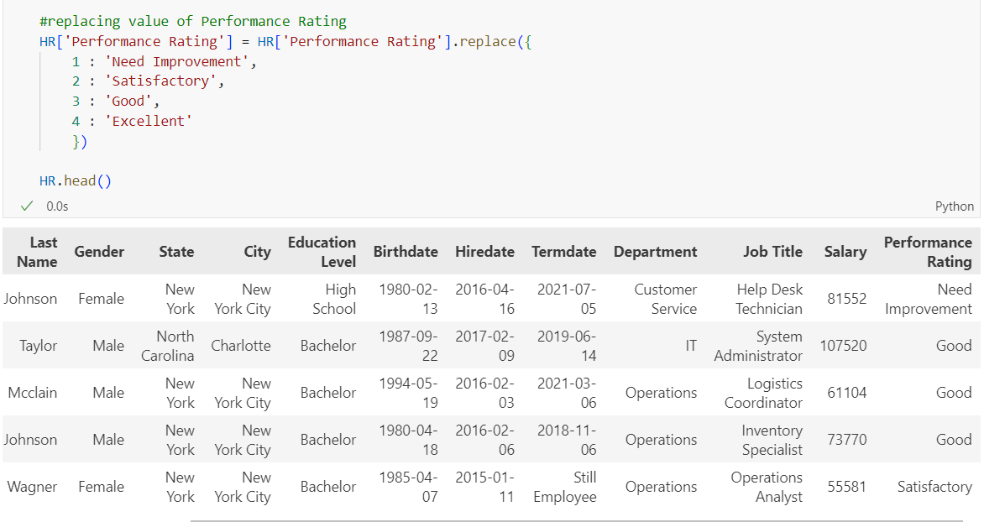
d-Replacing Values
The values 0, 1, 2, etc., were replaced with appropriate labels for each column.

Slide 10
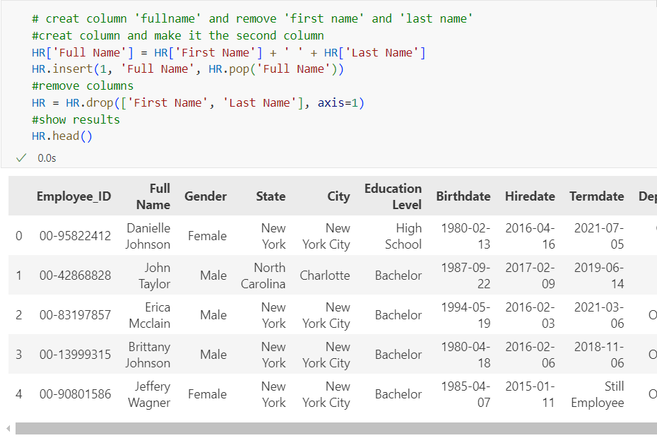
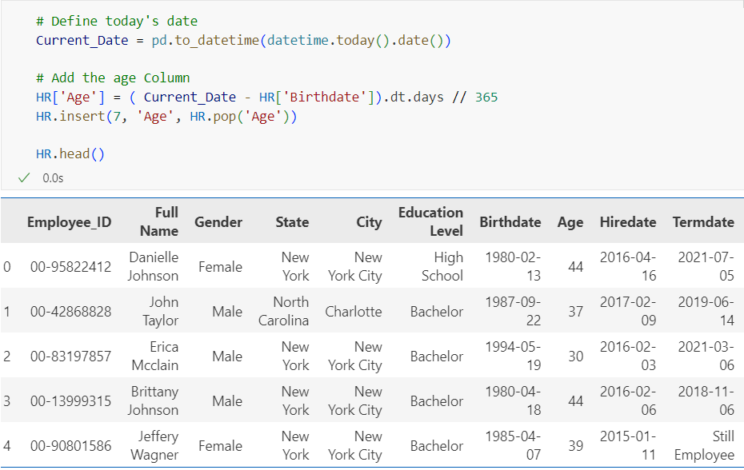
Add new Columns to Data

Slide 11
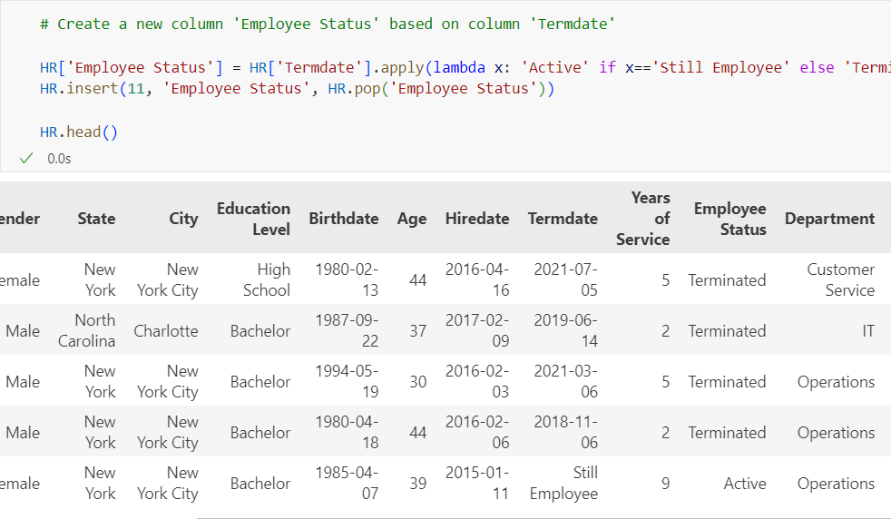
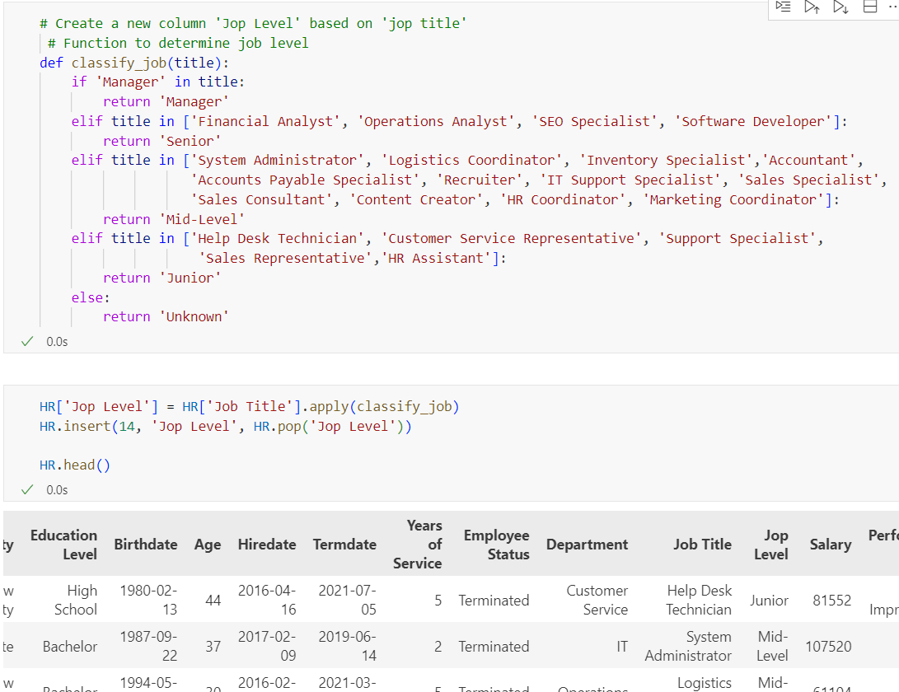

Slide 12
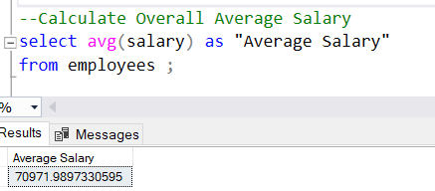
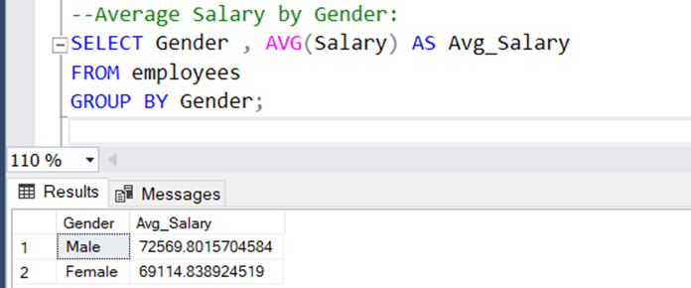
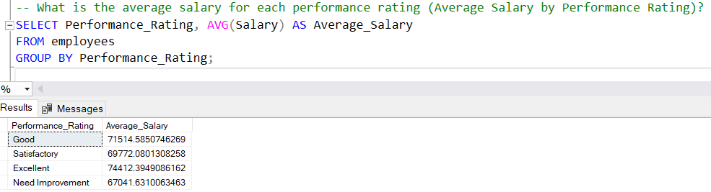
Answering the questions using SQL.

Slide 13
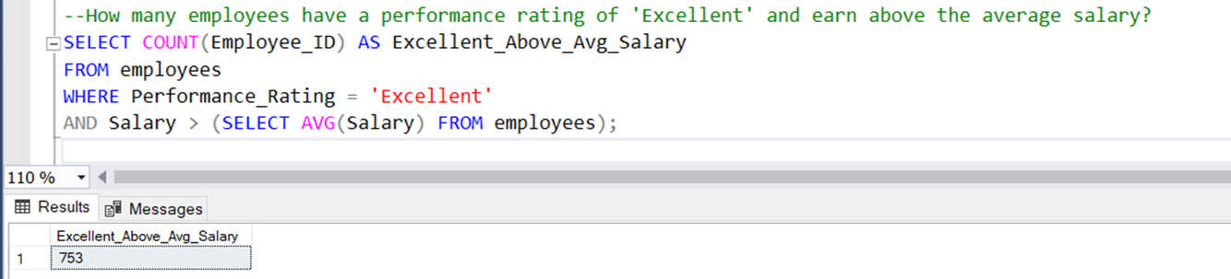
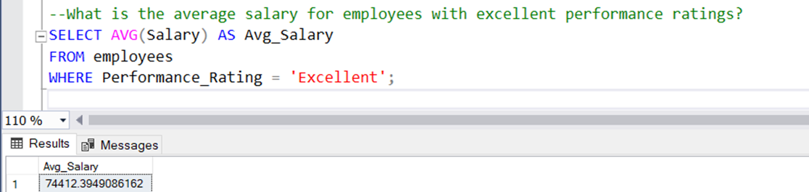
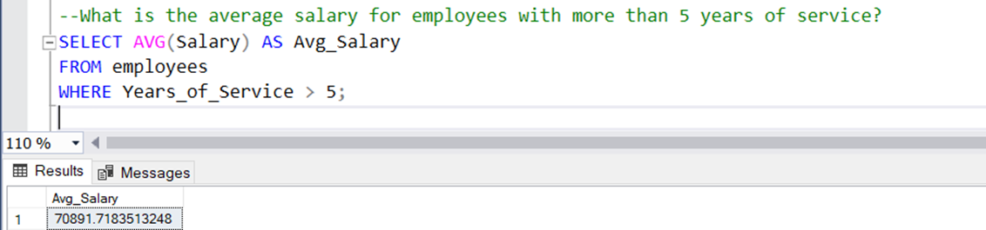
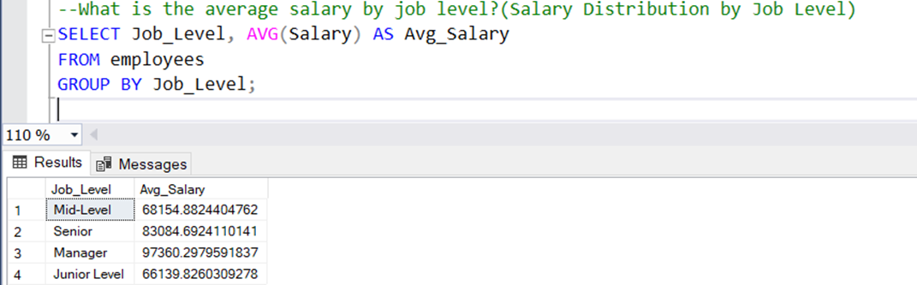

Slide 14
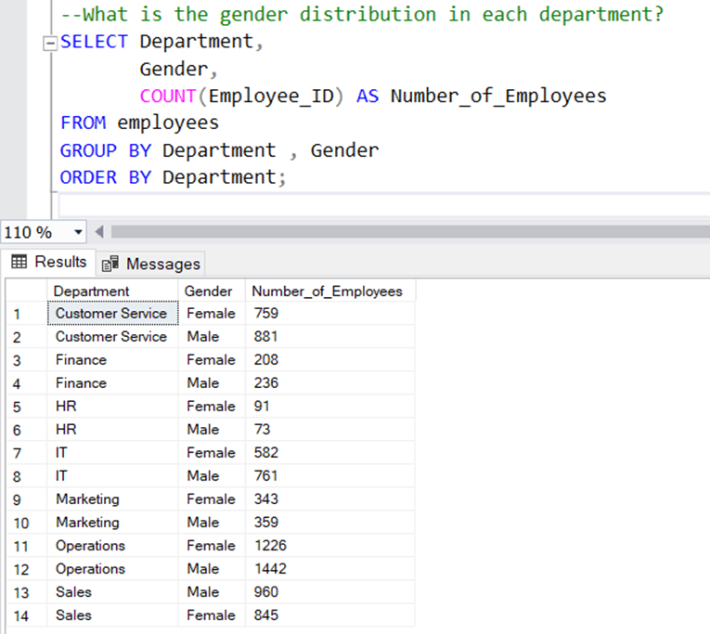
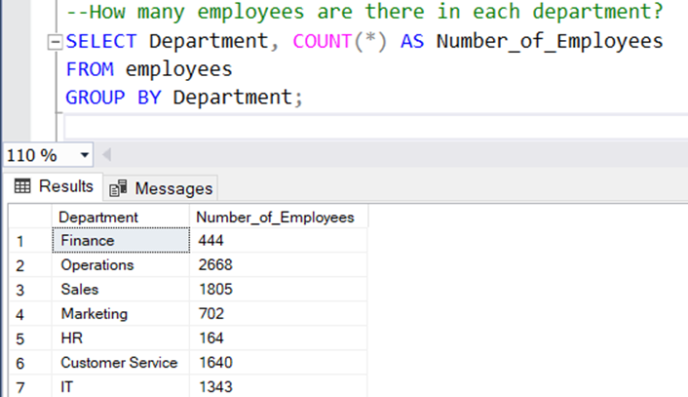
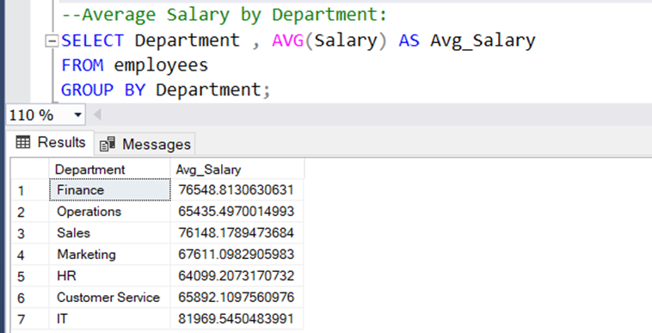
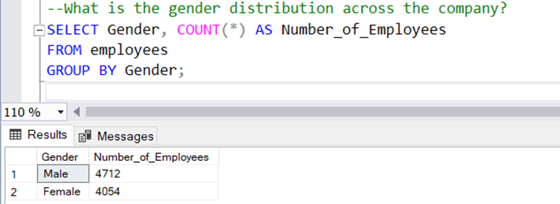

Slide 15
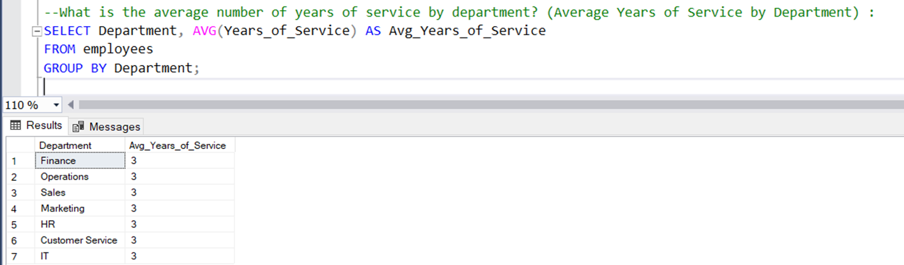
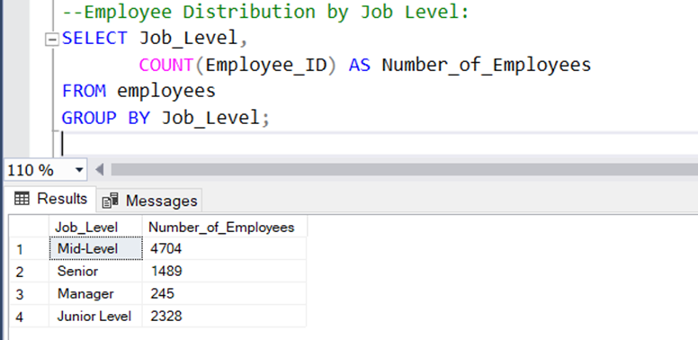
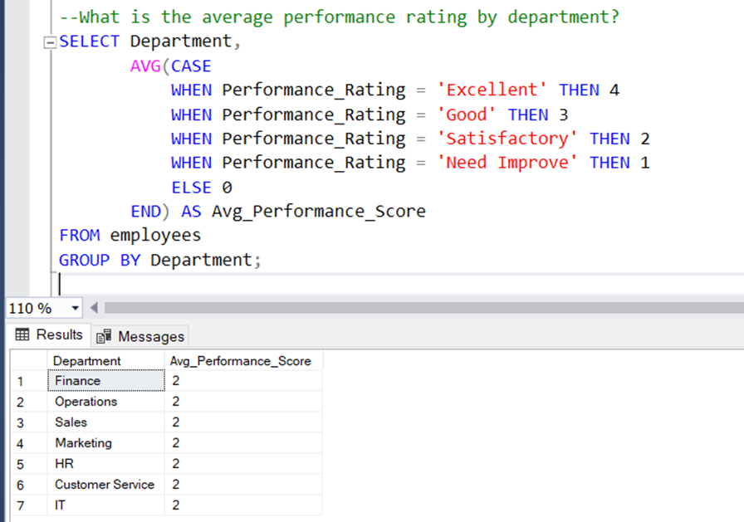
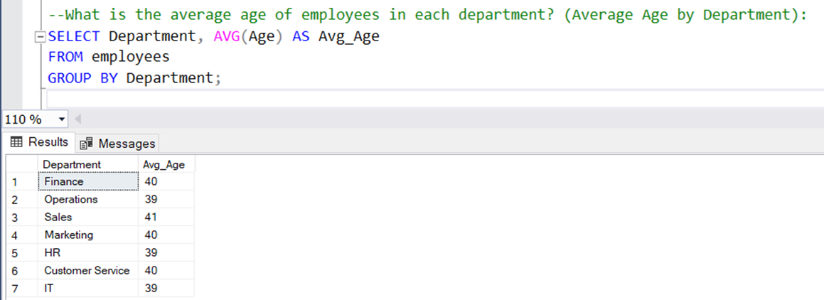

Slide 16
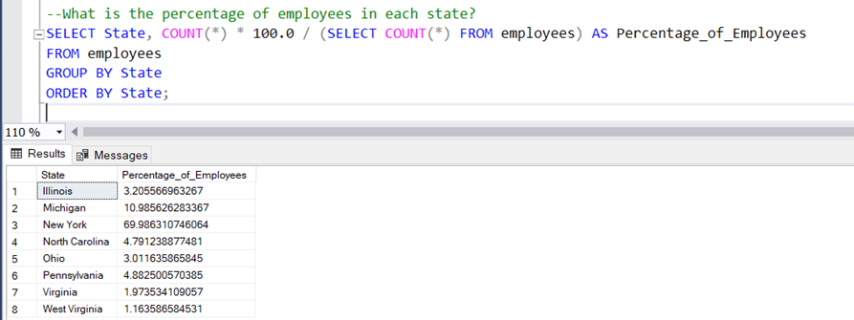
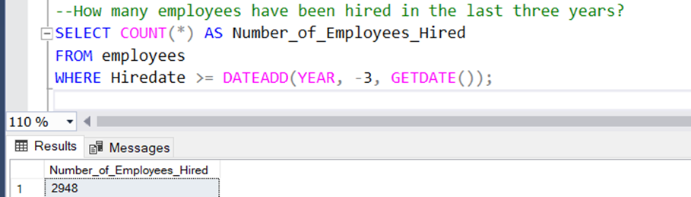
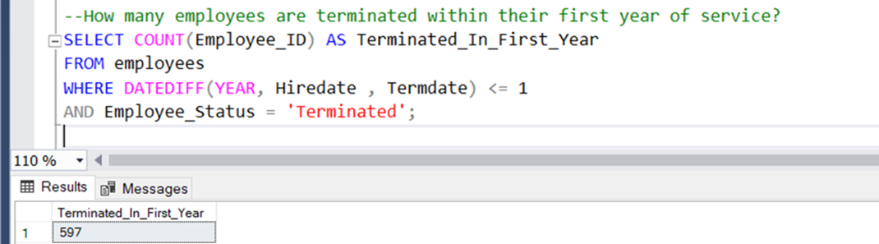
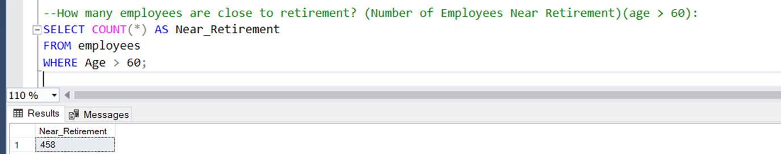
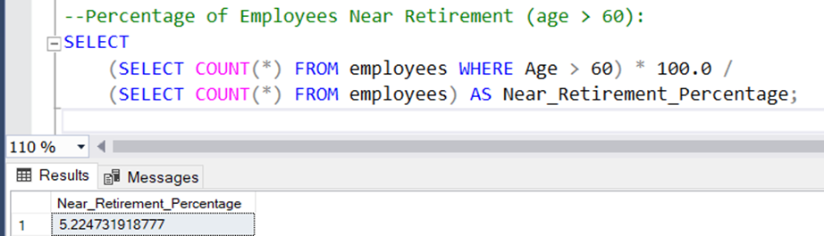

Slide 17
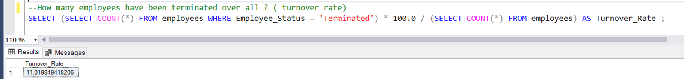
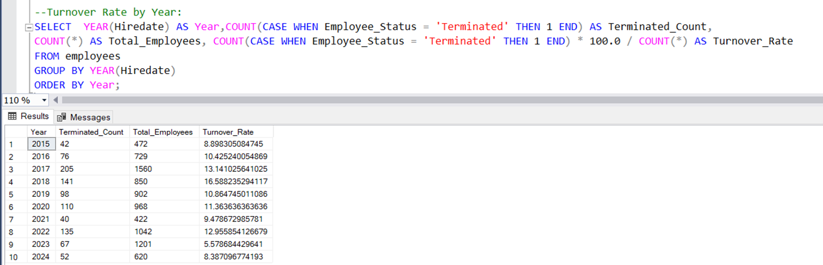
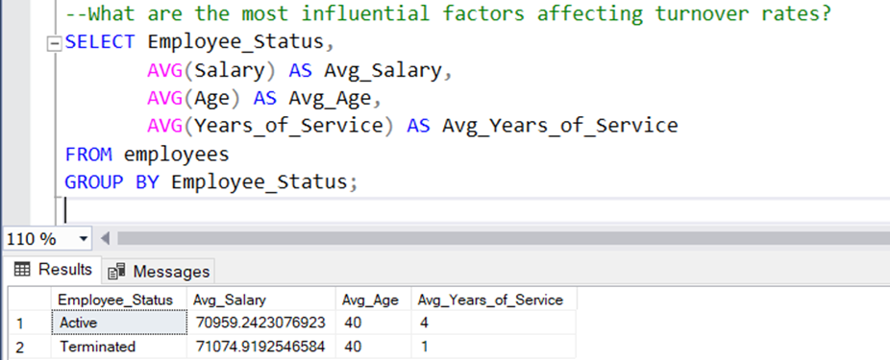

Slide 18
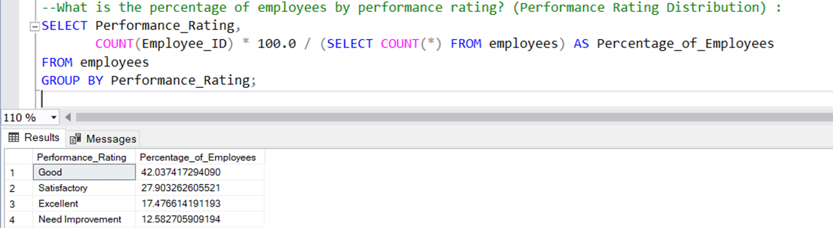
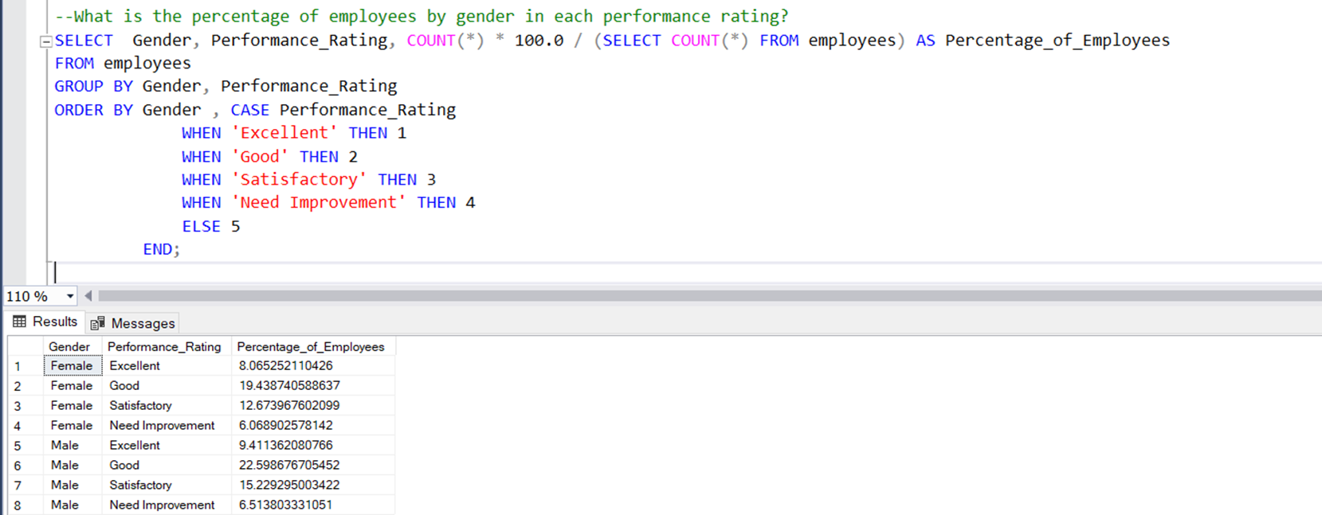

Slide 19
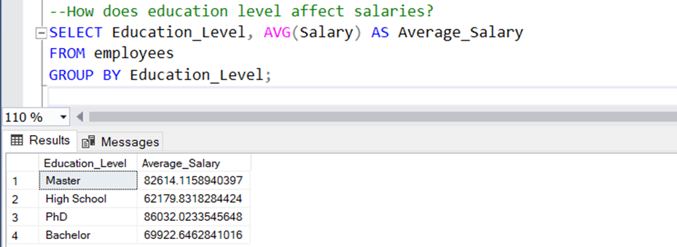
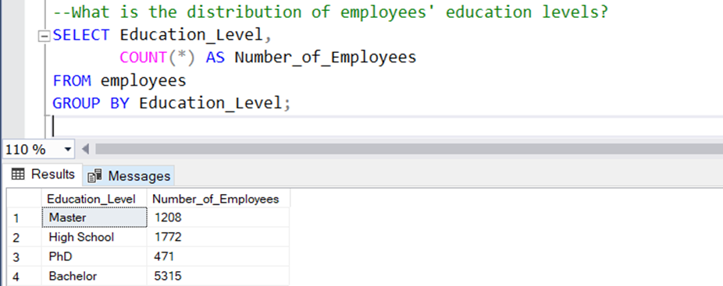
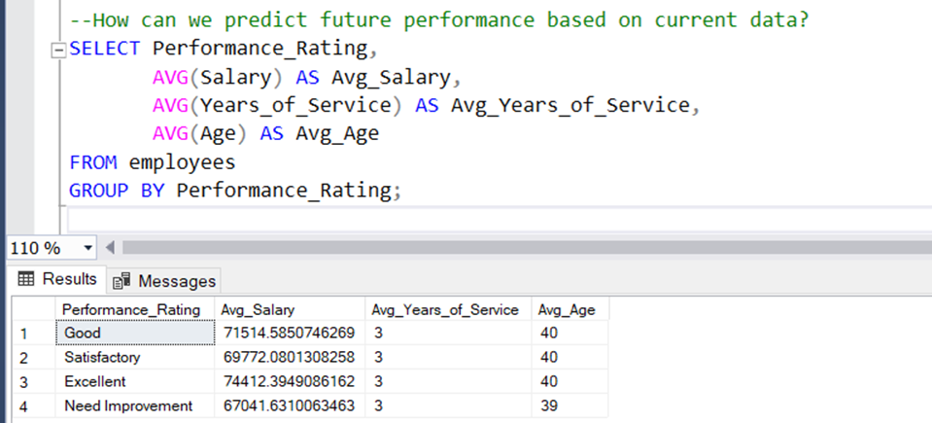

Slide 20
Answer Questions Using Python
An analysis of employee turnover, salary distribution, and promotions

Slide 21
Introduction
This report analyzes an HR dataset that includes key information about employees, such as their demographics, job roles, salaries, and turnover status. The objective of the analysis is to provide insights into patterns affecting employee retention, salary distribution, and promotion practices.

Slide 22
Turnover Analysis
Turnover is a critical HR metric. High turnover can be costly for organizations in terms of recruitment, training, and productivity loss. The turnover rate was analyzed by department.

Slide 23
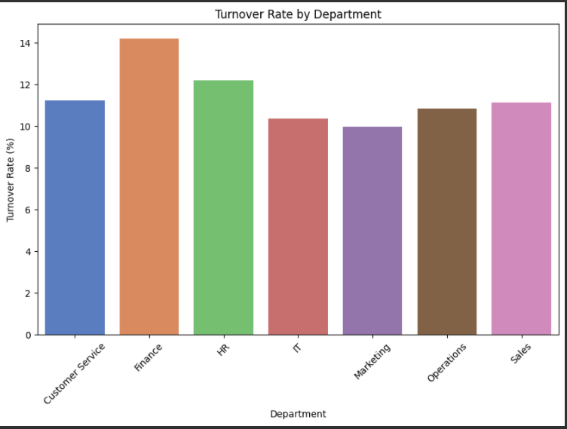
Turnover Rate by Department
- Sales and HR departments exhibit the highest turnover rates.
- Research & Development and Marketing have lower turnover rates.

Slide 24
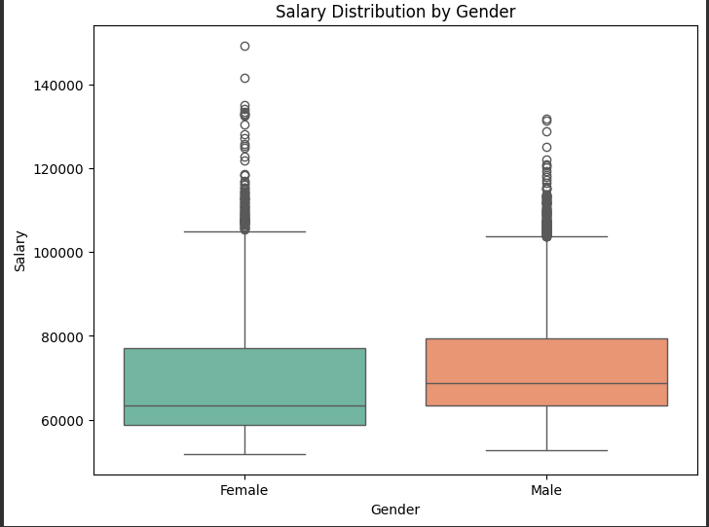
Salary Distribution Analysis
Salary distribution was analyzed by Gender:
- Some roles show wide variability in salaries (e.g., Females, Males).
- Salary disparities should be addressed, particularly for roles like HR Representatives.

Slide 25

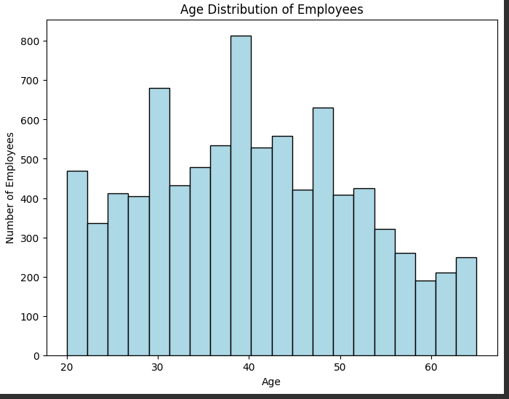
Age Distribution of Employees
The majority of employees is more than 30.
The lowest number of employees is mor then 50.

Slide 26
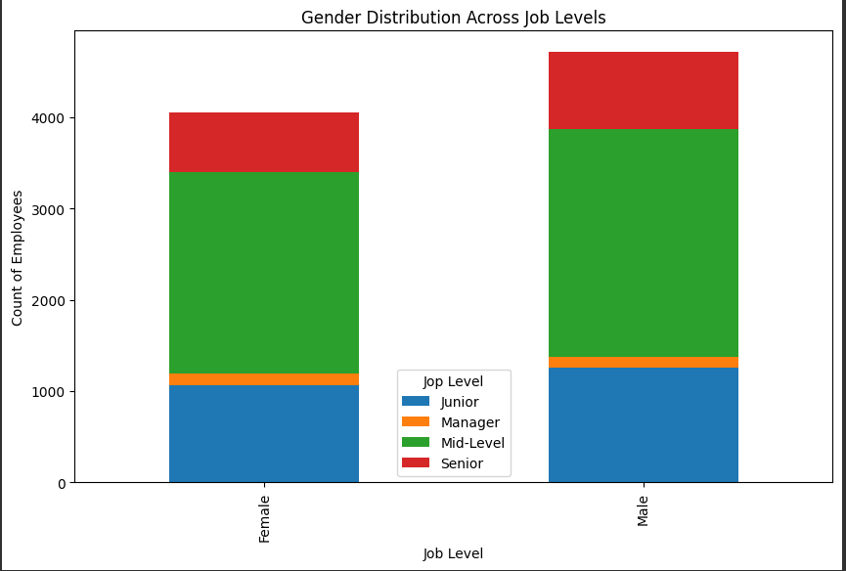
Gender Distribution across job levels
Highest number of employees is the mid-level.
Lowest number of employees is the managers level.

Slide 27
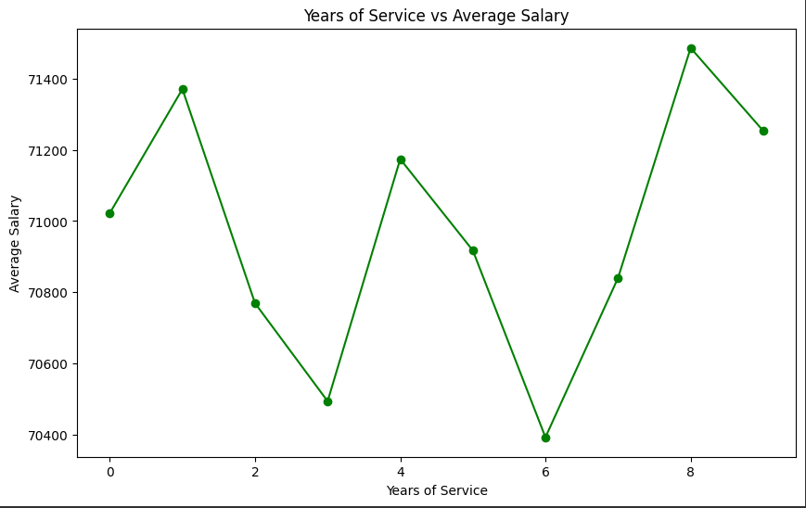
Years of Service Vs. Average Salary
Highest years of service (more than 8 years) is the most paid employee.
Lowest paid employee is with 6 years of service.

Slide 28
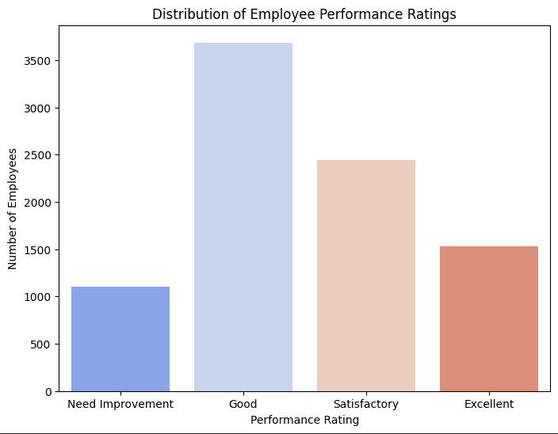
Distribution of Employees based on Performance Rating
Highest number of employees is the employees with good performance rating.
Lowest number of employees is employees the need improvement.

Slide 29
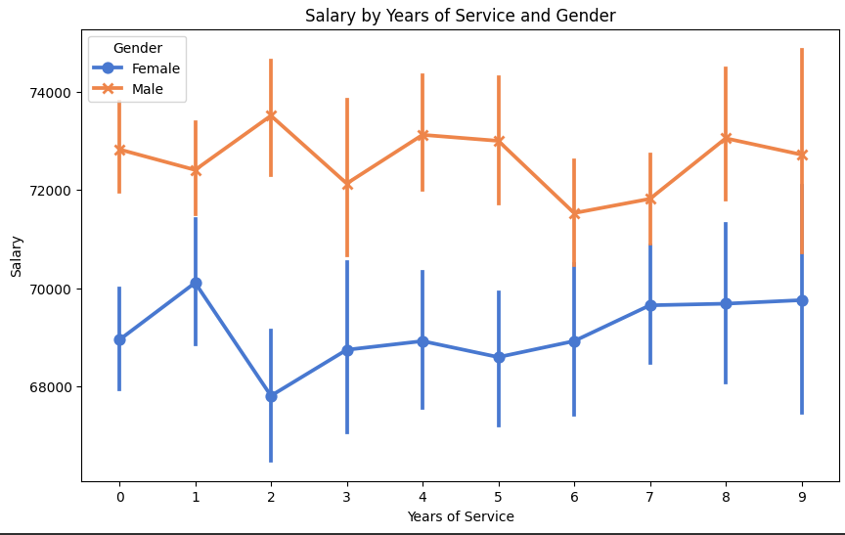
Salaries by Years of Service and Gender
Males have the higher paid average more than females.
The more years of service the higher the paid average.

Slide 30
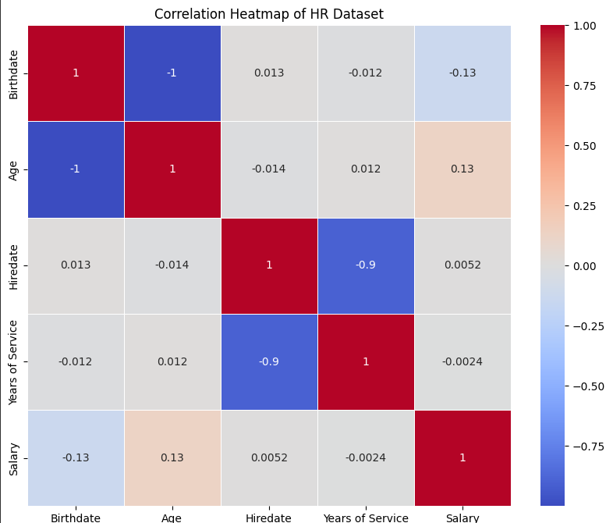
Correlation Heatmap for the Dataset
Correlation between Birthday and Salary: The correlation coefficient of -0.13 indicates a weak negative relationship between birthday and salary. This suggests that there is not a significant impact of birthday on salary levels.
Correlation between Birthday and Years of Service: The correlation coefficient of -0.012 reflects a lack of a clear relationship between birthday and years of service, indicating that the age of an employee when they start working does not significantly affect their length of service.
Correlation between Birthday and Hire Date: The correlation coefficient of -0.013 indicates that there is no significant correlation between birthday and hire date.
Correlation between Birthday and Age: The correlation coefficient of -1 indicates a perfect negative relationship, which is expected since birthday and age are directly related. This means that this correlation can be anticipated.
Correlation between Age and Salary: A correlation coefficient of 0.13 suggests a weak positive relationship between age and salary. This indicates that as an employee's age increases, their salary may also increase, but the effect is not strong.
Correlation between Age and Years of Service: A correlation coefficient of 0.012 indicates no significant relationship between age and years of service.
Correlation between Age and Hire Date: The correlation coefficient of -0.014 shows a lack of significant correlation between age and hire date.
Correlation between Hire Date and Salary: The correlation coefficient of 0.0052 indicates no clear relationship between hire date and salary.
Correlation between Hire Date and Years of Service: A correlation coefficient of -0.9 suggests a strong negative relationship between hire date and years of service, meaning that as the hire date increases, years of service may decrease. This may indicate frequent hiring or job changes.
Correlation between Years of Service and Salary: The correlation coefficient of -0.0024 suggests no notable relationship between years of service and salary.

Slide 31
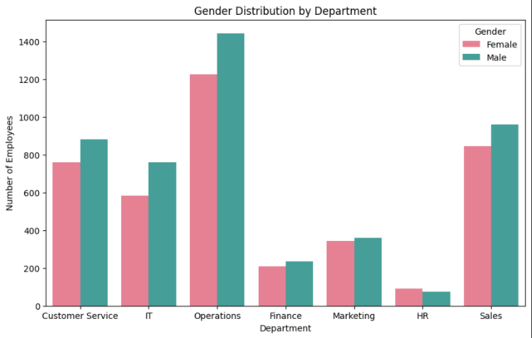
Gender Distribution by Department
Number of male employees in the operations, sales, customer service have the highest rate more than females.
Females have the highest rate in HR department.

Slide 32
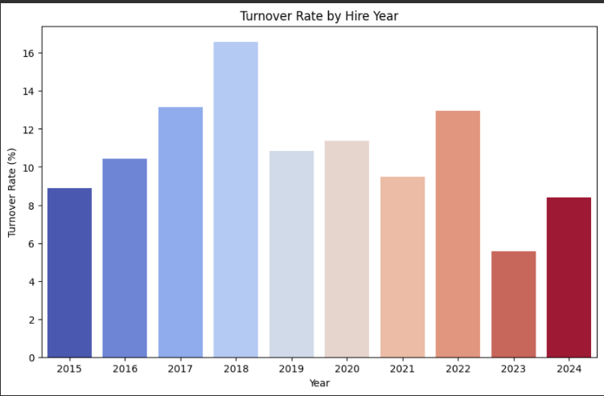
Turnover rate by Hire Year
2017 has the most turnover percentage with 16%.

Slide 33
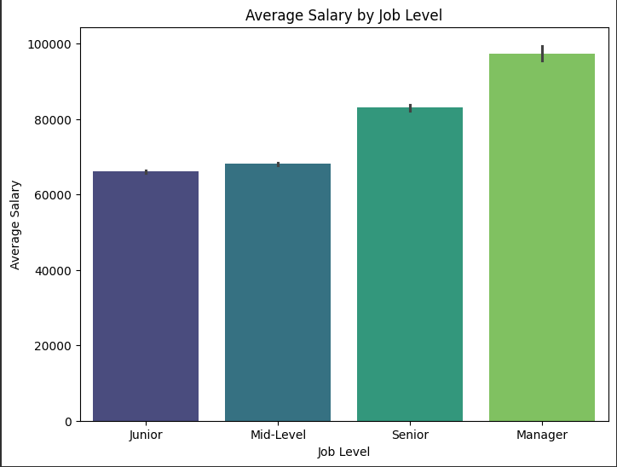
Average Salary by job Level
The highest salary is the manager level.
The lowest salary is the junior level.

Slide 34
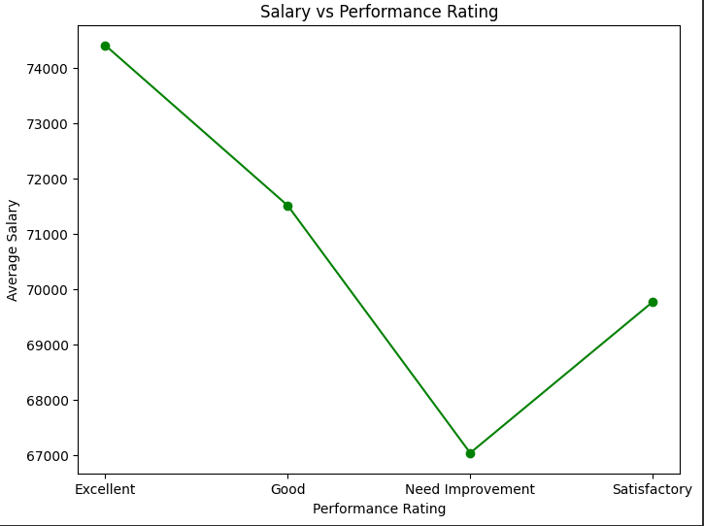
Salary Vs. Performance Rating
Employees with excellent performance are the highest paid salary.
Employees who need improvement have the lowest salary.

Slide 35

Years of Service Vs. Performance Rating

Slide 36

Relation Between Age and Average Performance Rating

Slide 37


blueprint

Slide 38
HR Tableau REPORT

Slide 39

Dashboard 1

Slide 40

Dashboard 2

Slide 41
Total Employees: The organization currently has a total of 8,766 employees contributing to its overall operations.
Average Salary: The average salary across all employees is approximately $71,000, reflecting the compensation structure within the company.
Average Years of Service: On average, employees have been with the organization for 4 years, indicating a moderate level of employee retention.
Total Number of Terminations: There have been a total of 966 terminations, highlighting the need for ongoing analysis of workforce dynamics and employee satisfaction.

Slide 42

Age Distribution
The "Age Distribution" chart shows that the majority of employees fall between the ages of 30 and 50, with a peak around 35 to 45 years old. There are fewer employees in the younger age group (20 to 25) and those over 60. This distribution indicates a workforce that is predominantly mid-career, with a smaller representation of both entry-level and nearing-retirement age employees.

Slide 43

Salary Analysis by Department
The "Salary Analysis by Department" table highlights the average salaries across the organization's departments. IT leads with the highest average salary of 81,970, indicating a premium for technical expertise. Finance and Sales follow, with average salaries of 76,549 and 76,148, respectively. In contrast, the HR department has the lowest average salary at 64,099. These figures suggest that it may be beneficial to reevaluate the salary structures for HR and Operations to enhance their competitiveness in the market.

Slide 44

Employee Distribution by Gender and Department
The "Employee Distribution by Gender and Department" table provides an overview of the number of male and female employees across the organization’s departments. The Operations department has the largest workforce, totaling 2,668 employees, with a relatively balanced distribution between genders. In contrast, the HR department has the smallest workforce, with only 164 employees. Across the organization, there are 4,054 female employees and 4,712 male employees. While most departments exhibit a balanced gender distribution, areas like Finance and HR could benefit from enhanced gender diversity. Analyzing the underlying factors influencing gender representation in specific departments may help shape future recruitment strategies.

Slide 45

Hiring Trend Over Time
The "Hiring Trend Over Time" chart highlights the variations in employee hires from 2015 to 2024. The peak year was 2017, with 1,560 hires, followed by a drop in 2018 to 850 hires. The trend remained relatively steady through 2019 and 2020, with slight increases to 902 and 968 hires. A significant decrease occurred in 2021, hitting a low of 422 hires, but the numbers rebounded in 2022 and 2023, reaching 1,042 and 1,201 hires, respectively. In 2024, the hiring rate declined again to 620. These fluctuations suggest changes in recruitment strategies or market conditions affecting hiring practices.

Slide 46

Employee Turnover Rate
The "Employee Turnover Rate" chart highlights that Finance has the highest turnover rate, followed by HR. In contrast, the IT department and Marketing have the lowest turnover rates. This indicates that Finance and HR may face challenges in retaining employees compared to other departments.
The IT department has the highest average salary and the lowest turnover rate. This suggests that good pay might help keep employees in IT. In Finance, even with a relatively high salary, the turnover rate is the highest. This means there could be other reasons people are leaving Finance. The HR department has the lowest salary but a moderate turnover rate. This shows that salary isn’t the only reason affecting how long employees stay in a department.

Slide 47

Employee Performance Analysis
The "Employee Performance Analysis" chart indicates that the Operations department has a higher proportion of employees rated as "Excellent" or "Good" compared to other departments. Sales and Customer Service also have a notable percentage of high-performing employees but show a greater mix of performance ratings. IT, Marketing, Finance, and HR departments have fewer employees in the "Excellent" category, with HR having the highest percentage of employees needing improvement. This suggests that Operations is the strongest-performing department overall, while HR might need more focus on performance improvement.

Slide 48

Job Level Salary Comparison
The "Job Level Salary Comparison" highlights the differences in average salaries across various job levels within the organization. Managers earn the highest average salary at 97,000, reflecting their leadership roles and responsibilities. Senior-level employees follow with an average salary of 83,000, showing a significant jump from the mid-level roles. Mid-level positions have an average salary of 68,000, slightly higher than junior-level roles, which stand at 66,000. The relatively small difference between junior and mid-level salaries may suggest room for growth in mid-level compensation to better reward experience and skills development. Overall, the data indicates a clear salary progression aligned with job level, but opportunities exist to further differentiate mid-level roles.

Slide 49

Numbers of Employees
The "Employee Distribution by Location" report shows that New York has the largest workforce, significantly outpacing other states. Michigan follows as the second-largest location, with several other states contributing smaller numbers of employees. West Virginia has the fewest employees among all locations. This distribution highlights New York as the primary operational hub for the organization, while other states support its workforce in a more limited capacity.

Slide 50

Performance Rating By Year
The "Performance Rating by Year" chart presents the distribution of performance data across different categories over the years. Each box represents the interquartile range, showcasing the middle 50% of data, while the line inside indicates the median. Dots outside the box represent outliers, highlighting data points significantly different from the rest. The "Excellent" category shows a narrow distribution, indicating consistent performance among those rated as excellent, while the "Good" category displays a wider distribution, reflecting more variation in performance levels. The "Need Improvement" and "Satisfactory" categories also exhibit wider distributions, suggesting greater variability in performance ratings. Overall, the "Excellent" category has the most stable performance, while the other categories demonstrate more variability, which may indicate differences in evaluation criteria or fluctuating performance levels.

Slide 51
Conclusion & Recommendations
Conclusion
Turnover Rates:
The Sales and HR departments exhibit the highest turnover rates, indicating potential issues that need addressing.
Research & Development and Marketing departments have lower turnover rates, suggesting better retention strategies or higher job satisfaction in these areas.
Salary Distribution:
There are noticeable salary disparities, particularly in roles like HR Representatives, which may need to be addressed to ensure fair compensation practices.
Males generally have higher average salaries compared to females, highlighting a potential gender pay gap.
Employee Demographics:
The majority of employees are aged between 30 and 50, with fewer employees in the younger (20-25) and older (60+) age groups.
The gender distribution is relatively balanced across most departments, though Finance and HR could benefit from enhanced gender diversity.
Performance Ratings:
The Operations department has a higher proportion of employees rated as “Excellent” or “Good,” indicating strong performance in this area.
HR has the highest percentage of employees needing improvement, suggesting a need for targeted performance enhancement initiatives.
Years of Service and Salary:
Employees with more years of service tend to have higher salaries, though the correlation is not very strong.
The highest salaries are observed at the managerial level, with a clear progression in salary with job level.

Slide 52
Recommendations
Address High Turnover in Sales and HR:
Conduct exit interviews to understand the reasons behind high turnover in these departments.
Implement retention strategies such as career development programs, mentorship, and improved work-life balance initiatives.
Review and Adjust Salary Structures:
Conduct a comprehensive salary review to address disparities, particularly focusing on roles with significant variability and gender pay gaps.
Consider implementing transparent salary bands and regular salary audits to ensure fair compensation practices.
Enhance Gender Diversity:
Develop targeted recruitment strategies to improve gender diversity in departments like Finance and HR.
Promote an inclusive workplace culture that supports diversity and equal opportunities for all employees.
Improve Performance in HR:
Provide additional training and development opportunities for HR employees to enhance their skills and performance.
Set clear performance goals and provide regular feedback to help employees in HR improve their performance ratings.
Support Career Development:
Implement career development programs that support employees in their professional growth and help them progress to higher job levels.
Encourage continuous learning and provide opportunities for employees to acquire new skills and advance their careers within the organization.
Monitor and Adjust Hiring Practices:
Analyze hiring trends to understand the factors influencing fluctuations in recruitment and adjust strategies accordingly.
Ensure that hiring practices are aligned with the organization’s long-term goals and workforce planning needs.
By implementing these recommendations, the organization can improve employee satisfaction, retention, and overall performance, leading to a more effective and motivated workforce.

